Slide 1
Policies and Regulations:
Exploration of Effects on Governing Data Systems
Mark Naughton
ITM 428

Slide 2
Abstract
As the demand for larger data infrastructures increase, so do the incidents of data breaches. The last ten years have seen a remarkable amount of breaches in data security. It appears that the current structure of policies created to combat these unlawful entries is purely reactionary, and lack of uniformity creates multiple levels of confusion. These incidents will continue to occur until a time in which policies become a determent to the cybercrime.

Slide 3
Database Growth = Intrusion Growth
Starts with Moore’s Law.
Processor Growth -> Technology leaps
Haim Mendelson of Standford University’s business school
Data needs to be treated as and protected like any high profile commodity.
The last 10 years (2005-2015)
The 10 largest data-breaches have occurred. (In terms of files stolen)
Evernote
Adobe
eBay
Target

Slide 4
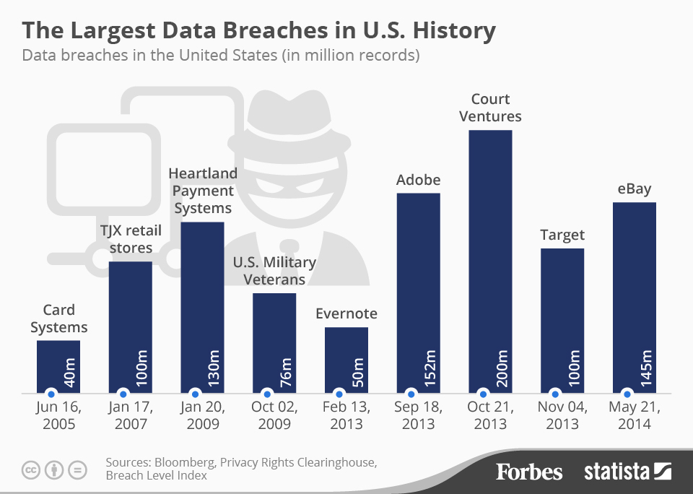
Top Ten List You don’t Want to be on!

Slide 5
100,000!
Also within the last 10 years:
Over 300 entities ( businesses, government entities, ect.) have had intrusions where at least 100,000 records have been stolen.
30 million personal and corporate records stolen.
This includes:
Names
Addresses
Credit Card #’s
Other information

Slide 6
The Fed
June, 2015
14 million former and current federal employees had their personal information compromised in a cyberattack.
This incident prompted U.S. Representative Joe Wilson to propose the Cyberattack Standards Study Act

Slide 7
Cyberattack Standards Study ACT
Bill passed and will be enabled in 2016
Will study the effects of cyberattacks
Defined by cyber incidents and responses to incidents

Slide 8
Obstacle for the Study
The most prevalent obstacle is a lack of regulation uniformity.
Multiple regulations
Multiple regulators
Confusion

Slide 9
The SEC
The SEC (The Security and Exchange Commission) regulates business and entities that deal with commerce.
Investment companies
Financial Advisors
Brokers
Dealers
They use Regulation S-P, a guideline for financial institutions

Slide 10
Regulation S-P
Assignment of enforcement duties to employees
Data security risk identification
Proper deployment of protection measures
Testing and training of personnel
Thorough oversight of policies and procedures
An issue with these: they lack definition.

Slide 11
Massachusetts State Law
Not only include regulations by S-P, but are more robust.
Defining disciplinary procedures for rule violations
Limiting access to protected information
Limiting vendor’s access to information
Thorough documentation of incidents

Slide 12
Not Every State is the Same
There is an overwhelming lack of uniformity between states.
California Law:
February 2005, Choi cePoint, a data collection service, was breached. California law mandates that the company is to disclose the full nature of the data breach to Californian residents.
Hawaii:
Disclosure is only required if there’s illegal usage of the stolen information.

Slide 13
States With Similar Laws to California
Connecticut
Rhode Island
Oregon
Maryland
Nevada

Slide 14
States Comparable to Hawaii
Alabama
Kentucky
New Mexico
South Dakota

Slide 15
CEOs Disagree on Disclosure
Fidels Security Systems President and CEO Peter George:
Proactive and full disclosure laws are a must
They will not harm businesses
Make corporations better informed about their security
Lieberman Software President and CEO Philip Lieberman:
Corporations should use discretion when disclosing breaches
Could cause financial loss
Leave corporation vulnerable to frivolous lawsuits

Slide 16
Individual Mandate
Since all companies, businesses, and institutions are different, each has their own adherence to laws and policies, as well as their own laws and polices.
Single greatest threat to the security of data systems is the individual.
Laziness, poor training, and lack of motivation attribute to the failure of security and non-compliance to policies.
Training and education are considered to be effective deterrents to security risks.

Slide 17
Conclusion
BECAUSE there is:
Steady progression of sophisticated data-breaches and cyberattacks.
Current policies on various levels have lapses in uniformity, and are often written after major breaches.
THEREFORE:
Uniform policies should help eliminate the need for different entities to create their own laws, and spend more time on training, education, and adhering to compliance; Creating pathways to more secured systems.

